Slide 1

Winners in a PANDEMIC
David Grimmett - Jon Smart
Andrés Solano - Brittney Hopkins
Mercan Aslan

Slide 2





A Massive Challenge or a Massive Benefit?
The global COVID-19 pandemic has forced risks and challenges to many industries
Unfortunately, many businesses have been impacted badly –some, forever gone
However, there are some industries/sectors that have benefited tremendously. Our goal is to take a closer looks at a few companies
COVID 19
??
E-commerce
TOURISM
Technology
FINANCE
Restaurant
industry
??
??
WORKFORCE

Slide 3
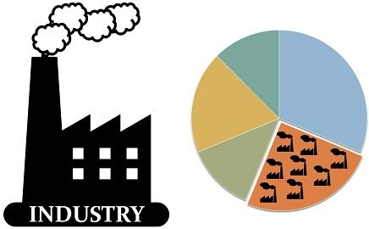
Industries vs. Sectors
Industry refers to a much more specific group of companies or businesses
Sector describes a large segment of the economy.
The terms industry and sector are often used interchangeably to describe a group of companies that operate in the same segment of the economy or share a similar business type.

Slide 4

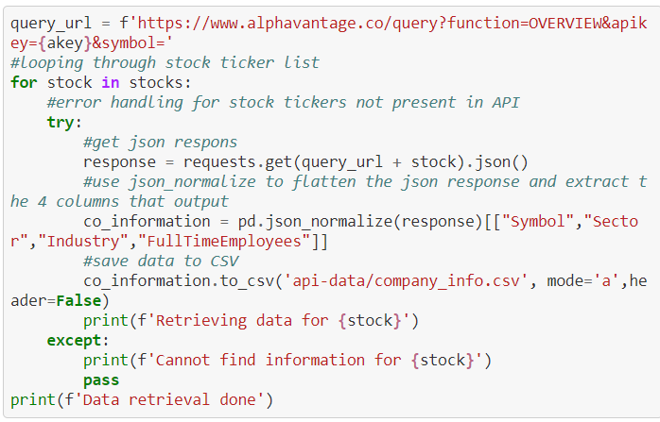

Something called an API

Slide 5
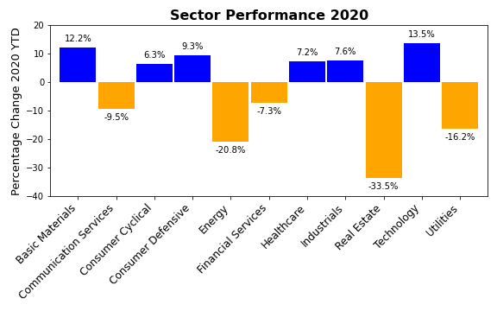
Statistical Analysis on Monthly Sector Performance for 2020

Slide 6
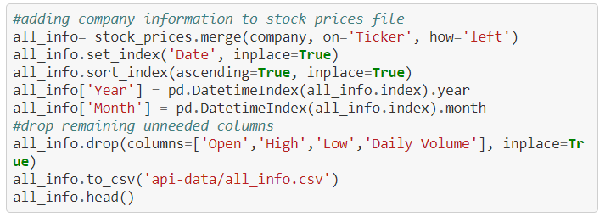
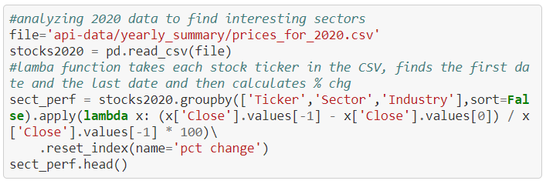
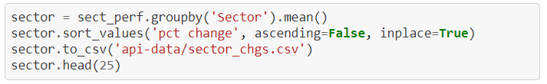
How to clean the code and calculate the sector performance?
1
2
3

Slide 7
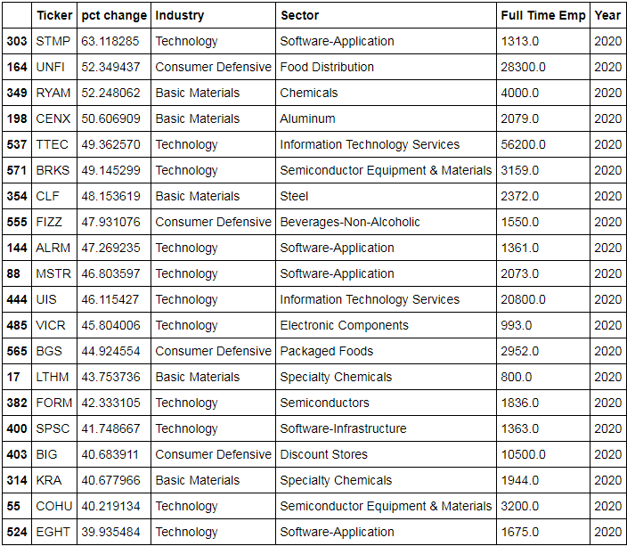
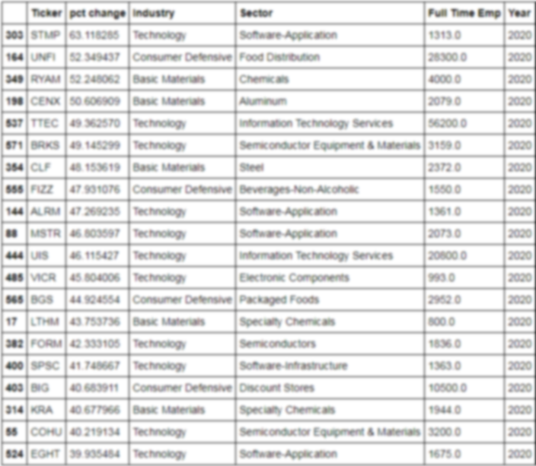
A closer look at some industry sectors and their companies
Technology
Basic Materials
Consumer
Defense

Slide 8
Where the magic begins
1
2
2
3
3
Notes:
Jon, will you please add in the code for the previous slide, or you could point it out and I can also add it early morning.

Slide 9
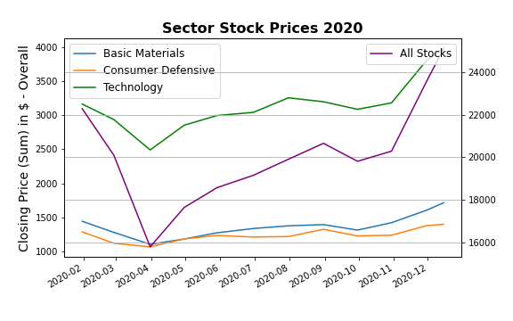
Comparison of Stock Prices in the Year 2020

Slide 10
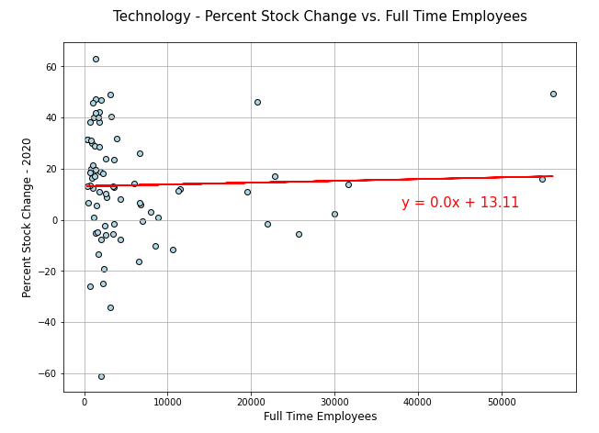
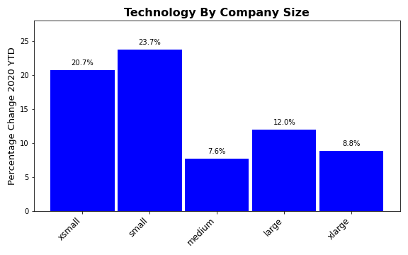

Technology
Electronic Components
Computer Hardware
Software (Applications & Infrastructure).
Consumer Electronics
Semiconductors and Semiconductor Equipment
Communications Equipment
Scientific & Technical Instruments

Slide 11
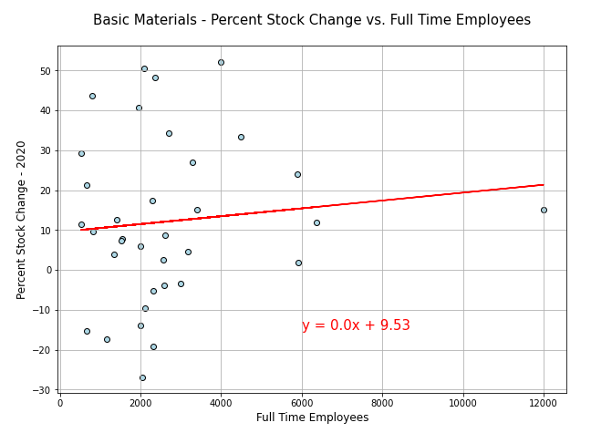
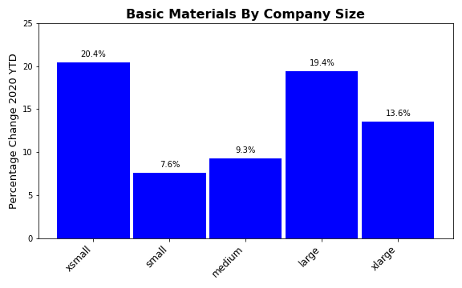

Basic Materials
Agricultural Inputs
Coking Coal, Building Material, Lumber
& Wood Production
Paper & Paper Products
Specialty Chemicals
Steel
Industrial Metals & Mining

Slide 12
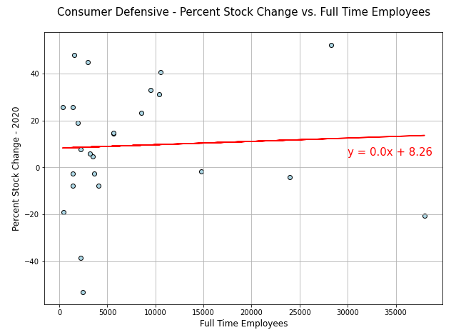
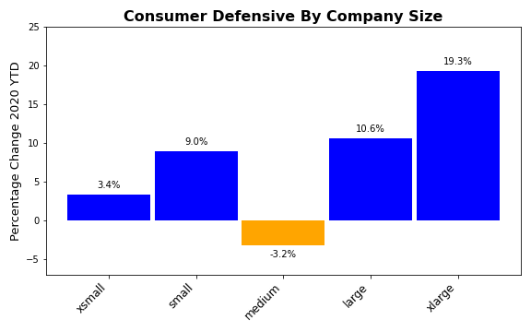

Consumer Defense
Packaged Foods
Education & Training Services
Farm Products
Beverages (Non-Alcohol)
Food Distribution
Tobacco
Household & Personal

Slide 13

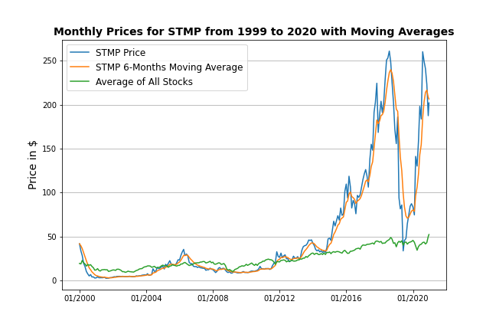
A provider of mailing and shipping solutions in the United States and Europe
Benefited greatly from e-commerce growth due to COVID
“TOO COLD TO GO TO THE POST OFFICE?”
Print official stamps and shipping labels from your own computer
Crash at the end of 2019 due to
discontinuation of partnership
with the Postal Service!

Slide 14

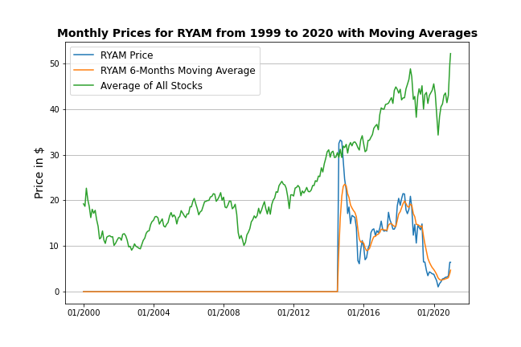
Edit-Add text

Slide 15
Add 3rd company and text

Slide 16
Forest Products Late in the second quarter, lumber sales prices surged on the back of strong repair and remodel activity with high demand for stud lumber. U.S. housing starts in September 2020 were approximately 1.4 million units, seasonally adjusted, which is an improvement from lows in April of 0.9 million units. Market prices reached all-time highs in September before trailing off in October. The Company expects strong volumes in the fourth quarter with historically high sales prices.
Rayonier Advanced Materials is an American chemical company specializing in cellulose-based products. Headquartered in Jacksonville, Florida, it produces more than 25 grades of high-purity performance fibers for products ranging from food, cosmetics, and pharmaceuticals to paints, filters, impact-resistant plastics, and digital display screens. In 2014, Rayonier and Rayonier Advanced Materials split into separate companies. Rayonier retained the real estate and forest resource components while Rayonier Advanced Materials took over management of the performance fibers division.
Notes:
You guys can ignore this slide. Mercan will delete it once 3 company slides are complete.

Slide 17
Conclusions
Final frame
IMPLICATIONS (Andreas)
Notes:
Andres can add in the Implications from project requirements

Slide 18
References
Ohio.gov
Census Business Formation Data
Stock Market Index….’
https://www.thebalance.com/what-are-the-sectors-and-industries-of-the-sandp-500-3957507
Ect…

Slide 19

Thanks!
This guy named Mark that work at Home Depot..
A couple rented their apartment in Santiago, traveled the worl…

